Slide 1

Joshua Rex, Benjamin Andrew,
Taylor Nairn, Wyatt Hudgins
Professor Sue Sampson
CSD 460
3/28/2024

Slide 2
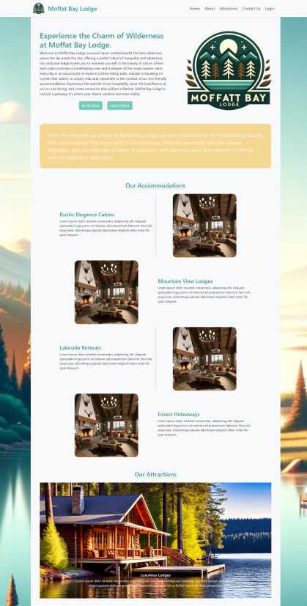
Landing Page
Prominently display logo
Warm, inviting photos displaying information at the lodge
Quick links on header and footer that will quickly bring clients to needed information

Slide 3
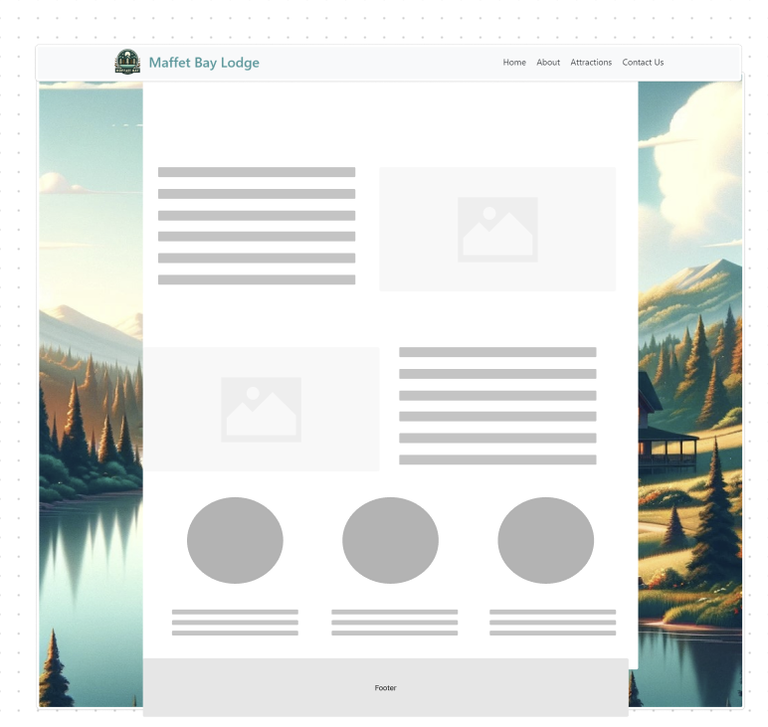
About Us
Information about the lodge and surrounding area
Pictures that will help sell the experience
Helpful travel tips for those coming out of state

Slide 4
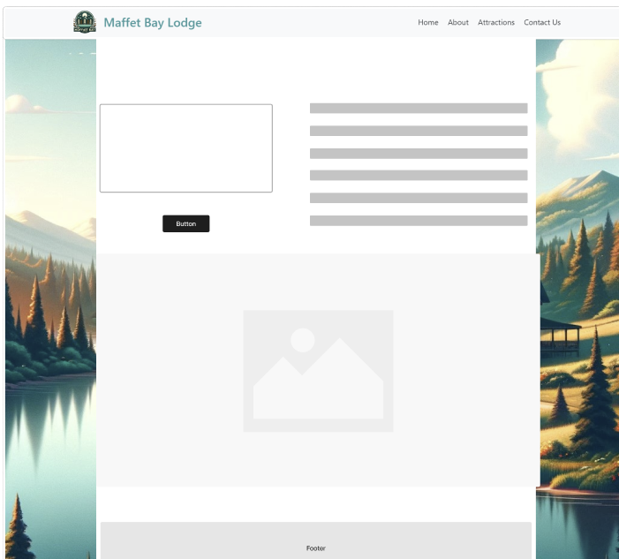
Contact Us
Email, phone, address displayed
Text box to submit a message directly on the website.

Slide 5
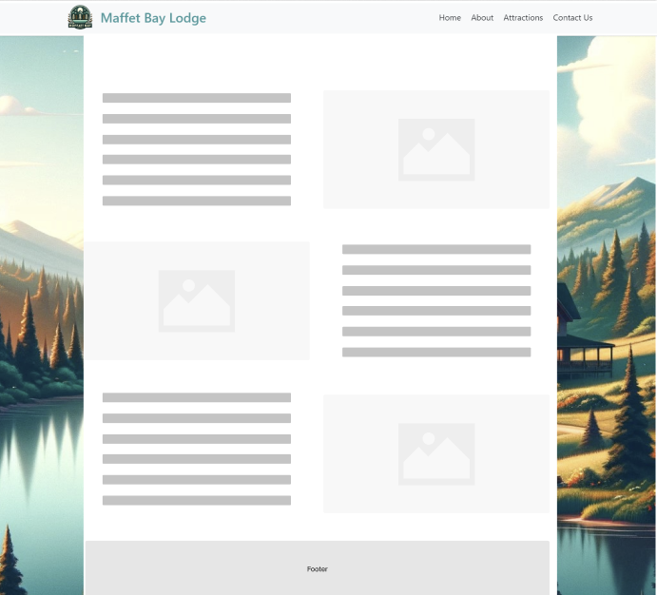
Attractions
Detailed descriptions of relevant activities to do at Moffat Lodge, with pictures of each one

Slide 6
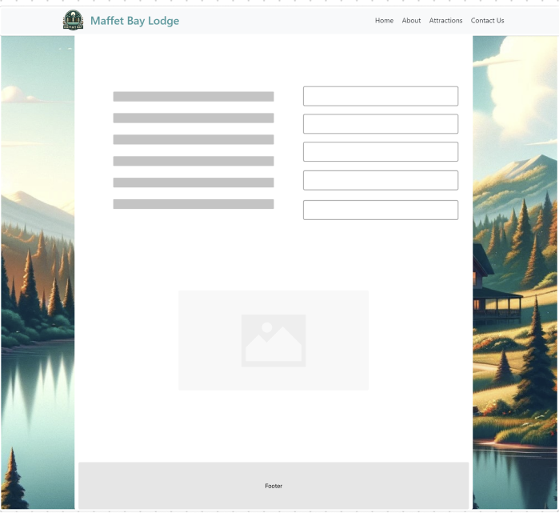
Registration
Quickly allow customers to enter relevant data so we can track their reservation and keep in contact.

Slide 7
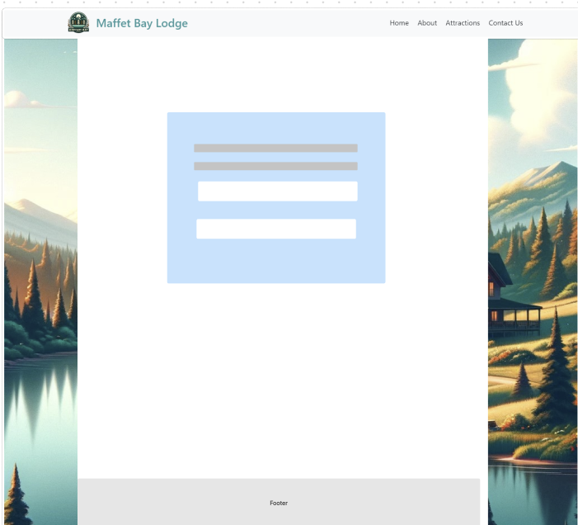
Login Screen
Simple login screen that allows users to start a session using their email address and password

Slide 8
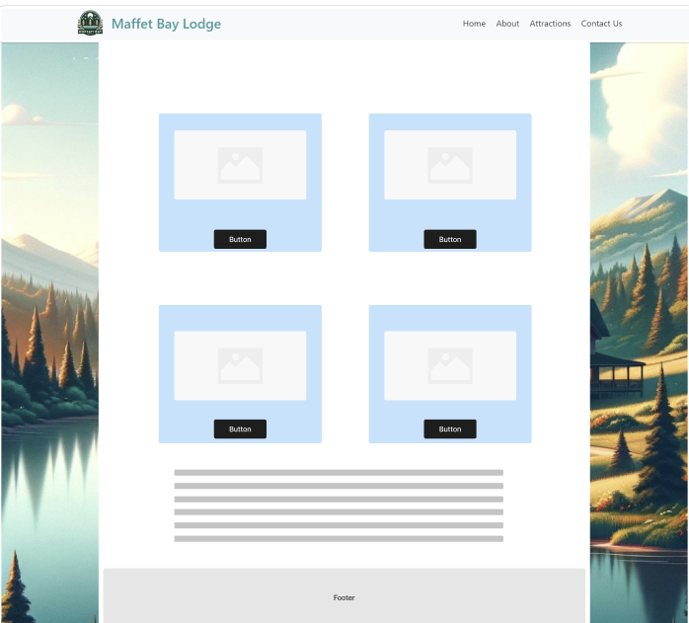
Make Reservation
Prominently display each type of room, with a button to book each.
Pricing and other details relevant to all rooms displayed at bottom.

Slide 9
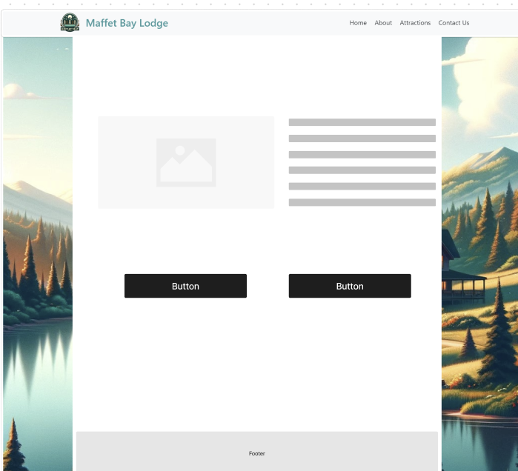
Reservation Confirmation
Displays guest selection
Buttons allow them to approve or cancel

Slide 10
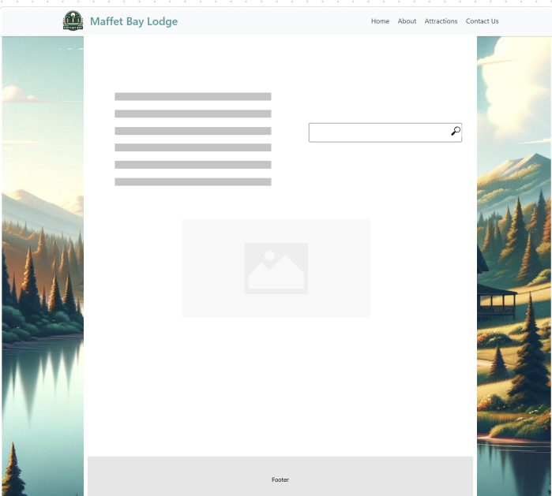
Reservation Lookup
Retrieve stored reservation information based upon previously entered information.

Slide 11
Resources
Wireframes created via Figma. Raw files may be found here: Moffat Bay – FigJam (figma.com)
Images are generated via AI or from Open Source websites like iStock

